Slide 1

Quantium x Forage Data Analytics Project
Vincent Chen

Slide 2
Agenda
1
Project Summary
2
Data Cleaning & Checks
3
Dashboard & Insights
5
Impact & Recommendation
6
Improvements

Slide 3


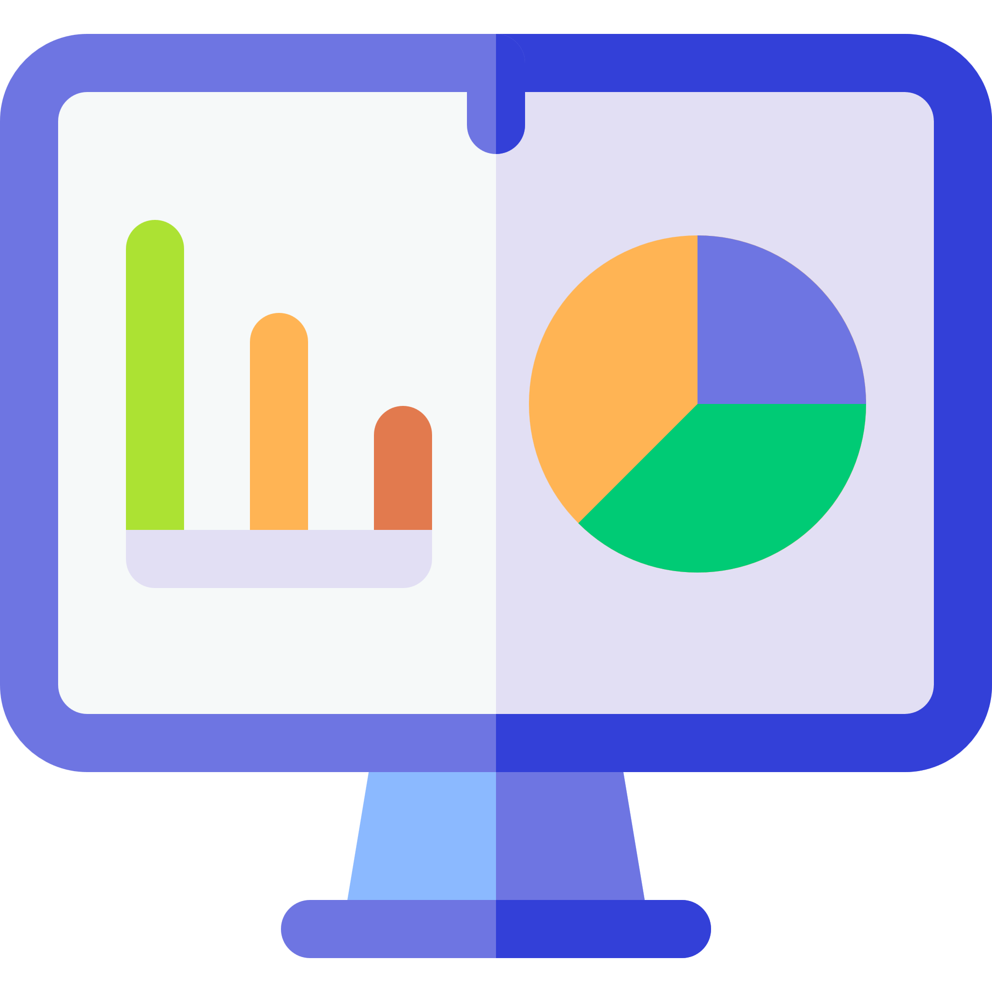

Project Summary
Problem
As part of the retail analytics team working for the Category Manager for chips, analyse the data and provide insights into customer segments as well as recommendations going forward.
Data
File | Data | Columns
QVI_transaction_data.csv | Transaction data | index, date, store number, loyalty card number, transaction id, product number, product name, product quantity, total sales
QVI_purchase_behaviour.csv | Customer data | loyalty card number, life stage, customer type
Solution
Load data into SQL to replicate industry
Clean and Transform data using Python & Jupyter Notebook
Create dashboard using PowerBI and perform analysis
Provide insights and recommendations

Slide 4
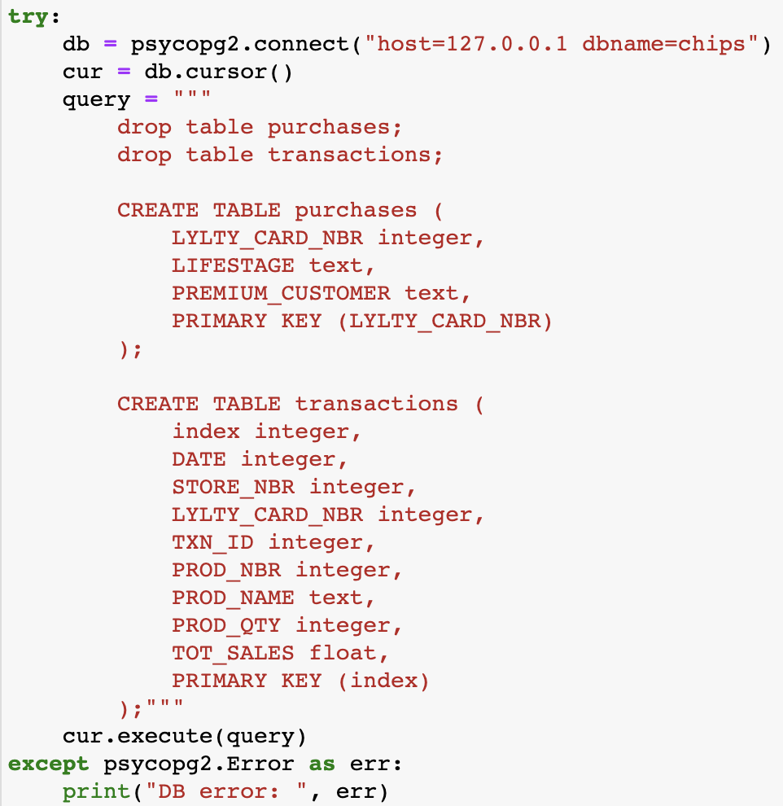
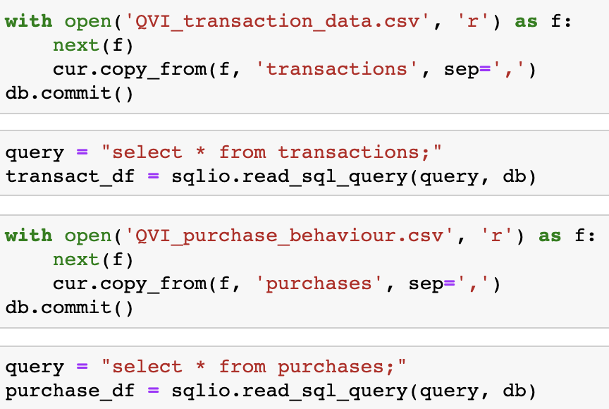
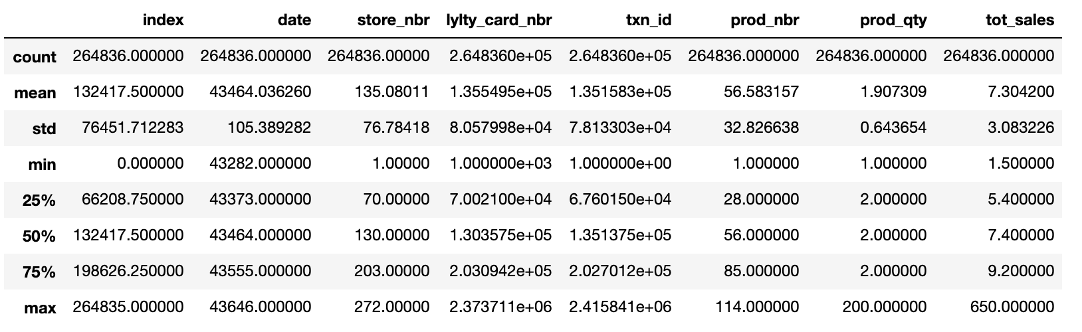
Data Cleaning & Checks
ETL Process
CSV Files
PostgreSQL
Connect to Python through pyscopg2
Data Cleaning
Output to dashboard
Observations and Cleaning
Purchase data had 72000 rows and Transaction data had 260,000 rows
Ran shape, describe, value counts on key fields such as customer type and life stage
Created ‘Brand’ feature – cleaned product name field using regex and extracted brand
Converted Excel dates to datetime format
No nulls present
Outliers – 200 chips purchased in one transaction, products which were ‘Salsa’

Slide 5
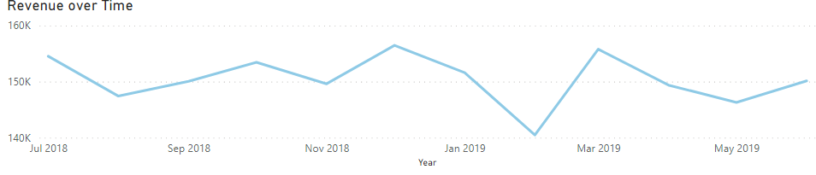
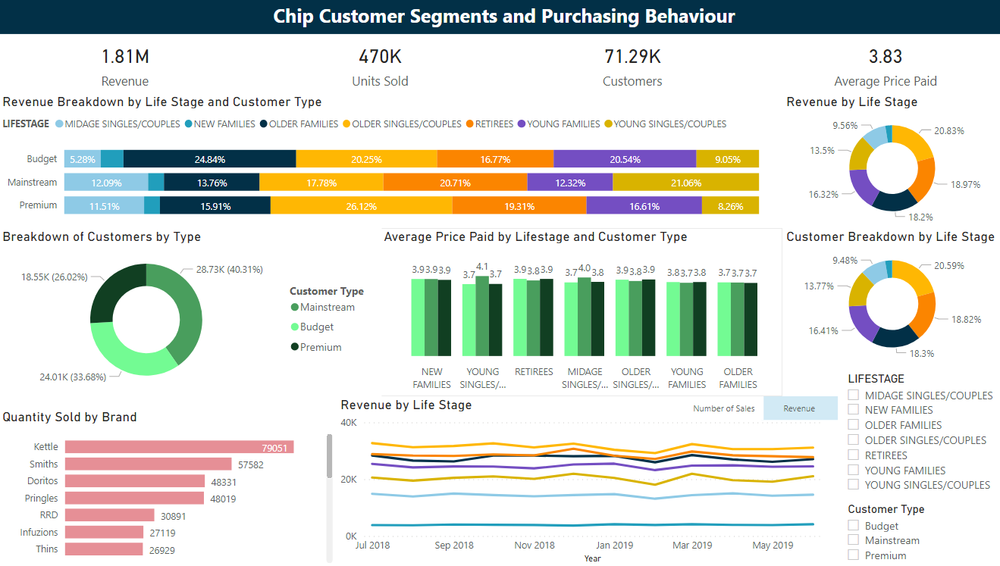
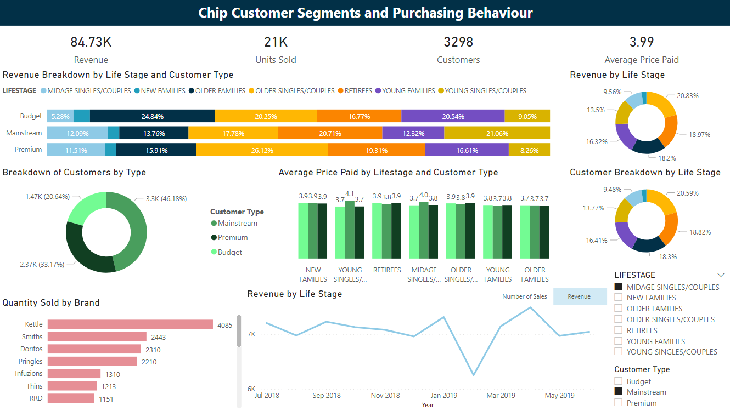
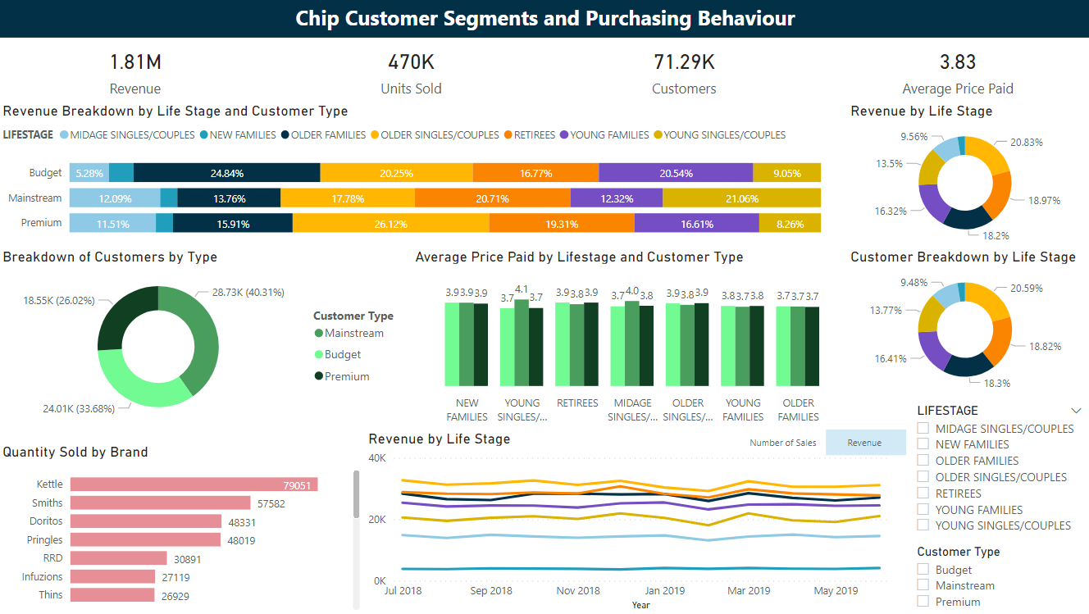
Dashboard & Insights
Insights
Sharp drop and then increase in revenue in Dec – Mar period and then a sharp upturn
Majority of sales due to older singles/couples, older families and retirees
Kettle is by far the most purchased brand
Customer base is somewhat evenly split with Premium being the lowest
Prices paid by customer is generally quite even except for a few

Slide 6

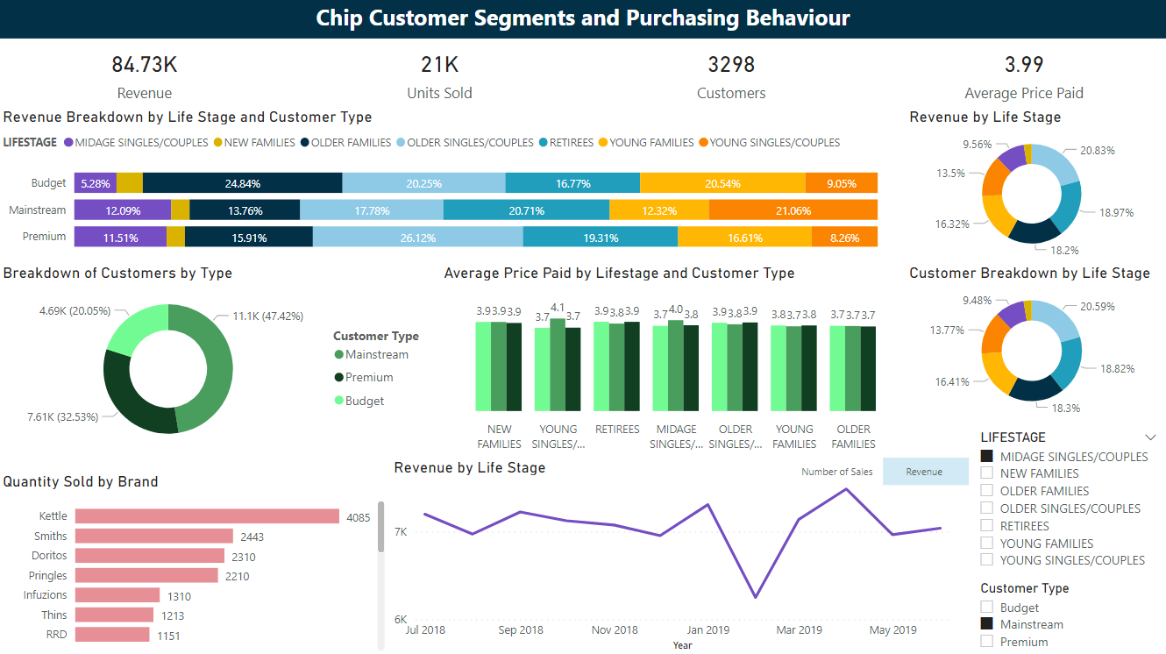
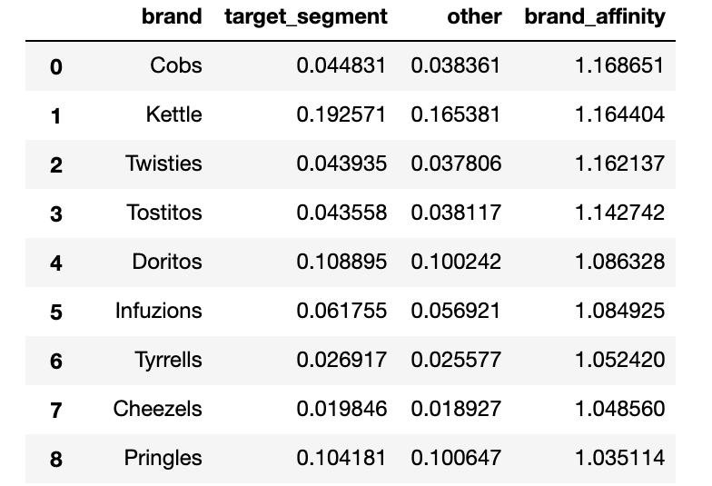
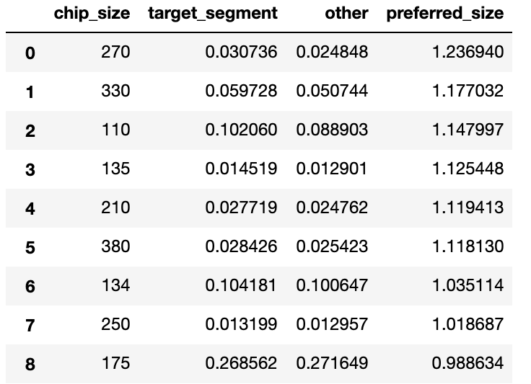
Dashboard & Insights: Deep Dive
Deep Dive Insights
Mainstream midage singles/couples pay a higher unit price for chips
T-test resulted in a p-value = 1.96e⁻⁶³ < 0.05, meaning that the unit price paid for mainstream midage singles/couples is significantly higher than that of budget and premium mainstream midage singles/couples
Kettle remains the most purchased brand
Number of mainstream customers is equal to the sum of the other two types
Sharper drop in revenue from Dec-Jan
Increase during Mar-May while general population seemed to decrease
17% more likely than other segments to purchase Cobs chips
Most likely to buy 330g size chips (270g is only offered by Twisties)
Brand Affinity Table
Packet Size Affinity Table

Slide 7




Impact of Insights & Recommendation
Midage Mainstream customer deep dive
General Recommendations
Health-conscious but enjoy group settings
Value convenience and independence
Marketing during Jan-Mar period
Segment-specific brand marketing and targeting
More like to buy chips for gatherings rather than themselves
Likely to pay higher price if convenient for them or they are craving it
Taking advantage of the increase after New Year’s resolutions fall through
Placing specific brands in places frequented by a certain segment
Recommendation
Recommendation
Promoting chips during gathering seasons more such as Christmas & Easter and placing them at the front of aisles for easy access
Promote chips as time approaches the mid-February/start of March and place specific brands near segment-specific areas e.g., vegetables for midage singles/couples.

Slide 8
Improvements
More in-depth analysis into brand of chips and packet size
Analysis into each store and breakdown of sales across different stores
Real-time data stream into dashboard rather than exporting and importing
Could use Plotly Dash
Forecasting future sales or revenue based on current data

Slide 9
Project Summary
Problem
As part of the retail analytics team working for the Category Manager for chips, analyse the data and provide insights into customer segments as well as recommendations going forward.
Data
File | Data | Columns
QVI_transaction_data.csv | Transaction data | loyalty card number, life stage, customer type
QVI_purchase_behaviour.csv | Customer data | index, date, store number, loyalty card number, transaction id, product number, product name, product quantity, total sales
Solution
Load data into SQL to replicate industry
Clean and Transform data using Python & Jupyter Notebook
Create dashboard using PowerBI and perform analysis
Provide insights and recommendations

